Slide 1
OLOW Science Fair 2021
November 2021
Investigate a topic that interests you
Present a Poster and an Experiment/ a Demonstration

Slide 2
Where do we start?
1. Ask a question.
What interests me?
Environment, food, body, animals, physics, how things work, how things interact with other things, plants……
I always wondered….
- why this happened?
- how this happened?
- what caused this to occur?
- what would happen if?

Slide 3
My Question is ….
Which laundry detergent is best to remove stains?

Slide 4
2. I know that….
I know that some detergents work better than others at removing stains.
I also know that different stains require different detergents in order to remove them.

Slide 5
2. I know that….
I know that using detergent when washing clothes removes common stains.
I know that there are many different brands of laundry detergent such as: Ariel, Bold and Persil. Which of these detergents is the most effective in removing these stains?

Slide 6
3. Time to research
Ask others what they think
Look up information on the internet about this topic
Laundry detergent is a type of detergent (cleaning agent) used for cleaning dirty laundry (clothes). Laundry detergent is manufactured in powder (washing powder) and liquid form. Ariel Washing Powder is listed online as the best detergent for removing stains on white clothing.

Slide 7
4. Hypothesis – My predicted guess
Ariel washing powder is the most effective laundry detergent at removing stains from white clothing.

Slide 8
5. The Investigation
I want to find out which laundry detergent is the most effective at removing stains from white clothing.

Slide 9
5. The Investigation
What will I do to get the evidence that I need to answer my question?
What laundry detergents will I use?
Powder or
Liquid or
Tablets
Does it matter if the water is hot or cold? Will that impact on how well the stains are removed?
I will use hot water only in my experiment.

Slide 10
5. The Investigation
I will test how effective the following are in removing stains;
Ariel Washing Powder
Bold Washing Powder
Persil Washing Powder
I need something to compare these to. What if I didn’t use any detergent at all? This will be my control and I will use it to compare my results.

Slide 11
5. The Investigation
For this to be a fair test, I must use the same white cotton.
I also need to:
Use the same quantity of detergent
Use the same stain quantities
Wash at the same temperature
Wash for the same length of time
Dry for the same length of time
The only variable is the detergent.

Slide 12
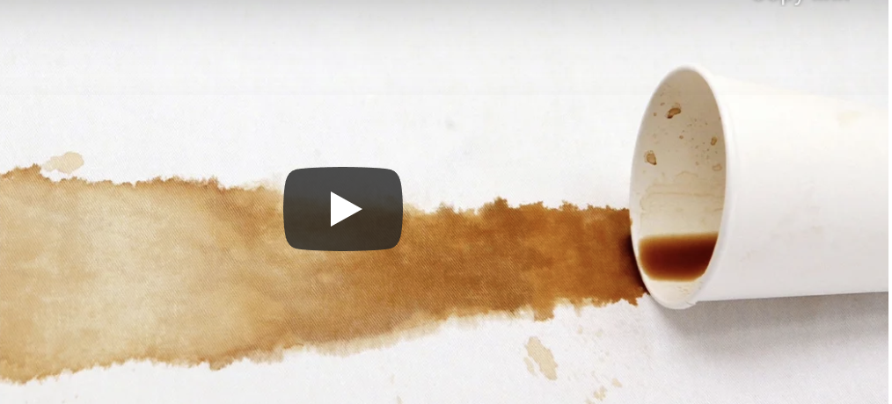
5. The Investigation
Coffee stains

Slide 13
5. The Investigation
Cut 100% cotton fabric into 10cm squares.
Use a permanent marker to label each piece of fabric. Use the following key: A=Ariel, B=Bold, P=Persil, C=Control
Boil a kettle and mix 80ml of hot water with 10 grams of ground coffee. This is your stain solution. Each time you place the stain solution on your fabric, you will use 20ml per square of fabric.
Pour 20 ml of the stain solution onto the fabric labelled A (on a plate).
Let the stain stay in the solution for 10 minutes.
Wash the piece of fabric on a ‘quick wash’ cycle.
Dry on a clothes rack for 24 hours.
***
Pour 20 ml of the stain solution onto the fabric labelled B (on a plate).
Let the stain stay in the solution for 10 minutes.
Wash the piece of fabric on a ‘quick wash’ cycle.
Dry on a clothes rack for 24 hours.

Slide 14
5. The Investigation
Pour 20 ml of the stain solution onto the fabric labelled P (on a plate).
Let the stain stay in the solution for 10 minutes.
Wash the piece of fabric on a ‘quick wash’ cycle.
Dry on a clothes rack for 24 hours.
***
Pour 20ml of the stain solution onto the fabric labelled C (on a plate).
Let the stain stay in the solution for 10 minutes.
Wash the piece of fabric on a ‘quick wash’ cycle.
Dry on a clothes rack for 24 hours.
***
Take pictures after each stain is first soaked in the solution for 10 minutes.
Record your results after 24 hours. Take pictures of your four pieces of fabric after 24 hours.

Slide 15
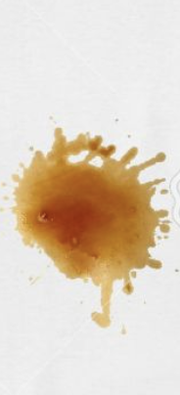
6. Collect Data – After 24 hours
A
B
P
C

Slide 16
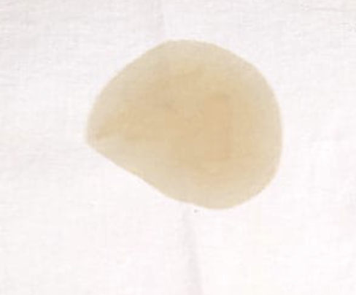
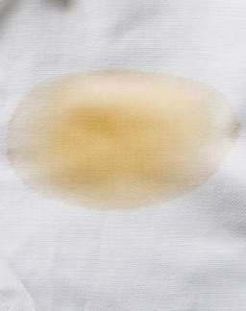
6. Collect Data – After 24 hours
A
B
P
C

Slide 17
6. Collect Data – Week 1
I will ask three different people which they think is the cleanest piece of fabric after 24 hours using the photos I have taken;
Ariel-
Bold-
Persil-
Control -

Slide 18
Results
I will present my results using a graph. The axes will be labelled with the names of the laundry detergents and the amount of ticks they received.
For example:

Slide 19
7. Observations
A
B
P
C
Fabric A (Ariel Washing Powder) was the cleanest after washing and drying.

Slide 20
7. Observations
A
B
P
C
I thought there would be a major difference between the three detergents. However, they performed similarly in their removal of the stain.

Slide 21
8. Conclusion
The fabric labelled A (Ariel Washing Powder) was the most effective in removing the coffee stain. This showed me that it is the most effective brand when compared to Bold, Persil and no detergent.

Slide 22
Presentation – Poster and Demonstration

Slide 23
Have a look at this video about the scientific method
https://www.youtube.com/watch?v=SMGRe824kak
Notes:
Stop video at 2 min 45 sec

Slide 26
Question

Slide 27
Answer or Hypothesis

Slide 28
Question
Does the amount of water a plant receives affect the growth rate of the plant?

Slide 29
Answer or Hypothesis

Slide 30
Question

Slide 31
Answer of Hypothesis

Slide 32
Remember to write a good hypothesis, use: If…, then…, because…

